Slide 1

Safe Beginnings
Poison Prevention

Slide 2



Safe Beginnings is brought to you by:
Innovative Partnerships Program: Sierra-Sacramento Region
  A 14-County Collaborative of Child Abuse Prevention Councils
In Partnership with:
The Office of Child Abuse Prevention
The Child Abuse Prevention Council of Sacramento
Funded, in part, by California Department of Public Health Kids’ Plates Program
Notes:
The Sierra-Sacramento Region Innovative Partnerships Program is a 14-county collaborative of Child Abuse Prevention Councils (CAPCs). The collaborative is composed of CAPCs from Alpine, Amador, Calaveras, El Dorado, Inyo, Mono, Nevada (East), Nevada (West), Placer (West/South), Placer (North), Sierra, Sutter, Tuolumne, Yolo, and Yuba Counties. The Sierra-Sacramento Region Innovative Partnerships Program joins the California Department of Social Services/Office of Child Abuse Prevention in our mutual goals of strengthening the capacity of prevention networks to build resiliency in families and implement prevention practices to reduce child abuse and neglect.

Slide 3
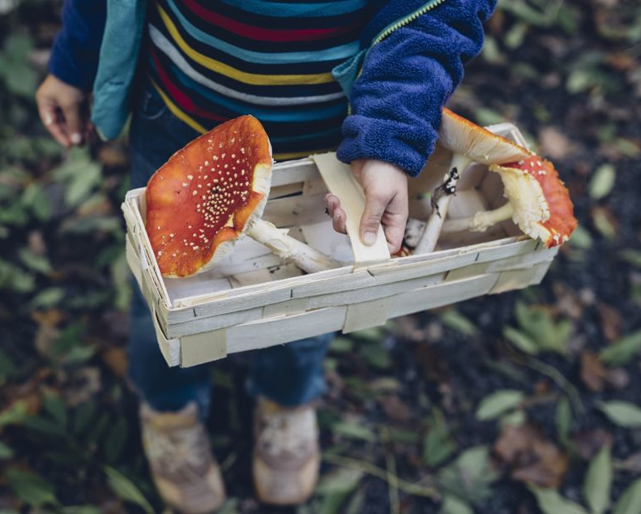
Purpose:
How to keep your child safe from poisoning
We are going to talk about:
Child Poisoning Statistics
Poisons in the Home
Poisons Outside the Home
When a Child Experiences Poisoning
Summary
Notes:
The purpose of this training is to provide information, tools, and resources to parents and caregivers of children age 0 to 5 that maximize safety and prevent unintentional injuries. By the end of this training, the participant will be informed as to how to prevent poisonings inside and outside the home.
Image of child holding basket of mushrooms: https://calpoison.org/

Slide 4
Child Poisoning Statistics
California
County

Slide 5
Child Poisonings in California
California (2018)
Nearly 215,000 calls were made to California poison control centers
More than 6,000 exposures to opioids (21% ages 0-19)
Nearly 200 exposures to e-cigarettes (75% ages 0-19)
Common exposures: pain relievers (12%), household cleaning substances (8%), cosmetics (7%)
54% of all California cases were for children ages 0-19
97% of cases occurred at home
78% of cases were unintentional
Source: https://aapcc.org/national-poison-data-system
Notes:
Information taken from: https://aapcc.org/national-poison-data-system
California (2018)
1 case every 147 seconds
24% of calls were made from health care facilities (52,546 cases)
Exposures to opioids include heroin and fentanyl
10% <= 5 years old
2% 6-12 years old
9% 13-19 years old
Exposures to e-cigarettes
60% <= 5 years old
2% 6-12 years old
13% 13-19 years old
Total cases
41% <= 5 years old
5.3% 6-12 years old
7.5% 13-19 years old
How exposures occurred
78% unintentional
18% intentional
4% adverse reaction, other, unknown
Sacramento
1 child death caused by poisoning/overdose (Sacramento County CDRT Report, 2016)
1 opioid overdose death for ages 0-19 (Sac Opioid Coalition, 2017 - http://sacopioidcoalition.org/statistics/)
In California in 2018, there was an overall rate of 12.8 per 100,000 for drug overdose deaths (CDC - https://www.cdc.gov/nchs/pressroom/states/california/ca.htm)
In 2015, 98.6% of children tested in California had a blood lead level of 0-4.5mcg/dL (https://trackingcalifornia.org/lead/query)
98.2% of children tested in Sacramento County had a blood lead level of 0-4.5mcg/dL
In 2018, there was an age-adjusted rate of 20.7 per 1,000,000 for ED visits due to CO poisoning, all causes (fire, non-fire, unknown) in California (https://trackingcalifornia.org/co/query)
In 2018, there was an age-adjusted rate of 19.8 per 1,000,000 for ED visits due to CO poisoning, all causes (fire, non-fire, unknown) in Sacramento County
Poison data resources:
https://www.poison.org/poison-statistics-national
https://www.poison.org/~/media/files/aapcc-annual-reports/npds2018.pdf?la=en

Slide 6
Child Poisonings in [Your County]
Include any county-specific data here.
Check these sources to find data for your county
Can find various county-level data here:
  https://trackingcalifornia.org/main/maps-and-data
Sources:

Slide 7

Introduction to the California Poison Control System https://youtu.be/ZTUwH26ryac
Notes:
Video can be found at:
https://youtu.be/ZTUwH26ryac
https://calpoison.org/you
Alternate videos can be found at:
https://poisonhelp.hrsa.gov/resources/videos
https://safekids.org/safetytips/field_risks/poison (scroll to Resources at the bottom of the page)

Slide 8
Poisons in the
Home
Medications
Household products
Food poisoning
Carbon monoxide
E-cigarettes and liquid nicotine
Marijuana

Slide 9
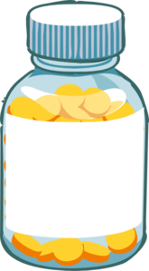
Poisons in the Home: Medications
Examples: Over-the-counter medications (Robitussin, Tylenol, etc.), prescription medications, vitamins
How Medication Poisonings Happen:
Medication poisonings happen when children swallow medications accidentally or when children are given too much of a medication.
Nine out of every 10 poisonings, for children ages 12 and younger, involve medication errors or unsupervised children taking medicine on their own.
Sources: https://www.preventchildinjury.org/toolkits/medicationsafety https://www.aafp.org/afp/2010/0201/p316.html https://ittrdetox.com/2019/07/25/symptoms-of-drug-toxicity/
Notes:
Image of medicine bottle: http://clipart-library.com/clipart/944086.htm
Information taken from:
https://www.preventchildinjury.org/toolkits/medicationsafety
https://www.aafp.org/afp/2010/0201/p316.html
https://ittrdetox.com/2019/07/25/symptoms-of-drug-toxicity/
Possible symptoms*: Altered mental status, behavioral changes, sleepiness, confusion, changes in vital signs, loss of consciousness, clamminess, seizures
*Reactions and symptoms will vary based on the medication and the amount of exposure

Slide 10
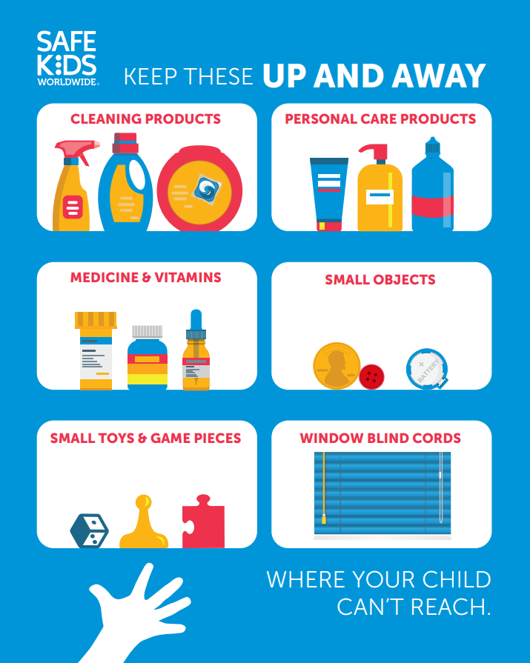
Medications: Prevention
Source: https://calpoison.org/you/prevent
Notes:
Up and Away infographic: https://safekids.org/infographic/childproofing-steps-six-items-keep-and-away
Information taken from:
https://calpoison.org/you/prevent
Medications: Prevention
Use only child resistant covers and keep in locked cabinets
Return to safe storage immediately after use
Always measure out the correct dose–don’t guess
Pay attention to expiration dates
Never tell children that medicine is candy
Model behavior – Do not take medicine in front of children
Keep all purses and other containers that may contain medications out of child’s reach
Practice proper disposal of medication
More information on medications:
https://www.preventchildinjury.org/toolkits/medicationsafety
https://aapcc.org/prevention/over-counter-medicine-safety
https://aapcc.org/prevention/medication-safety
https://aapcc.org/prevention/older-adults-medicine-safety
https://aapcc.org/track/opioids

Slide 11
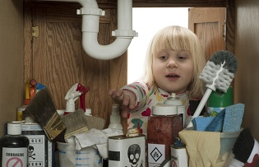
Poisons in the Home: Household Products
Examples: Laundry detergent and cleaning supplies, pesticides and insect repellants, batteries, oils (e.g., fragrance oil, engine oil, etc.), personal care products (e.g., contact lens solution, hand sanitizer, etc.)
How Household Product Poisonings Happen:
Household Product poisonings happen when children eat, touch, or otherwise come into contact with certain common household products.
Each year, more than 90% of exposures reported to poison control centers occur in the home.
Sources:
https://www.preventchildinjury.org/toolkits/laundry-detergent-packets
https://aapcc.org/prevention/home
https://aapcc.org/track/hand-sanitizer
Notes:
Image of child reaching into sink cabinet: https://www.nsc.org/home-safety/safety-topics/other-poisons/household-products
More information on household products:
https://www.preventchildinjury.org/toolkits/laundry-detergent-packets
https://aapcc.org/prevention/home
https://aapcc.org/track/hand-sanitizer
Possible symptoms*: Skin/eye irritation, inability to swallow, convulsing, loss of consciousness
*Reactions and symptoms will vary based on the product and the amount of exposure

Slide 12
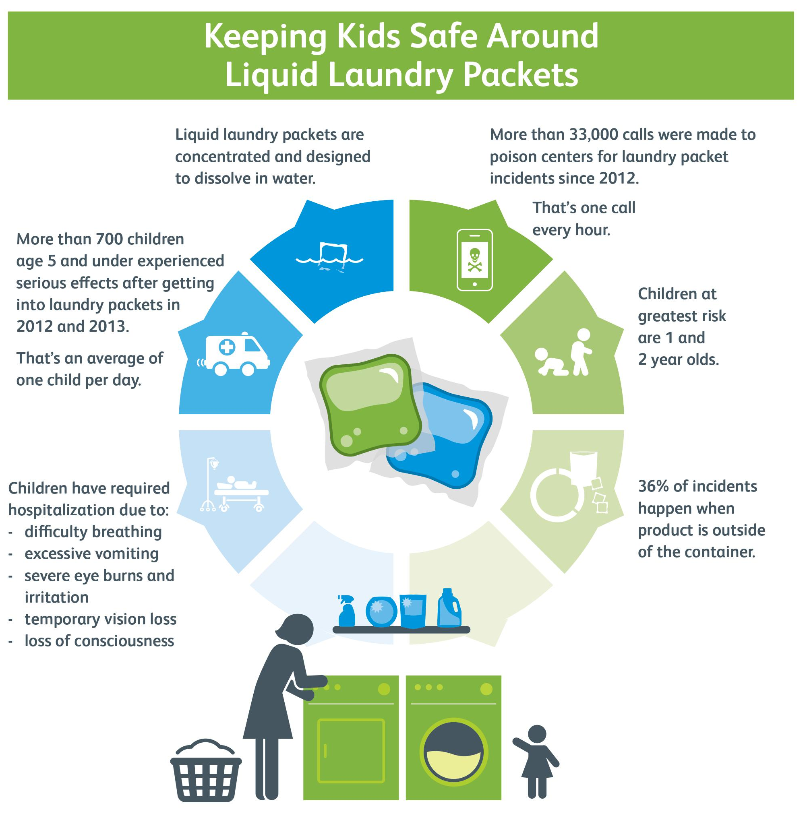
Household Products: Prevention
Source: https://calpoison.org/you/prevent
Notes:
Keeping Kids Safe Around Liquid Laundry Packets infographic: https://safekids.org/infographic/keeping-kids-safe-around-liquid-laundry-packets
Information taken from:
https://calpoison.org/you/prevent
Household Products: Prevention
Keep in mind that there is no such thing as a 100% child-proof lock or container
Use child resistant covers and original containers
Keep in locked cabinets
Store products and food in separate areas
Return products to safe storage immediately after use
Always keep an eye on your child when a product is within reach
Read and follow labels and directions
More information on household products:
https://www.preventchildinjury.org/toolkits/laundry-detergent-packets
https://aapcc.org/prevention/home
https://aapcc.org/track/hand-sanitizer

Slide 13
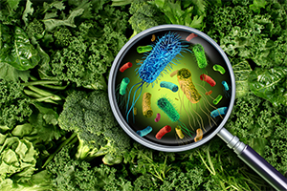
Poisons in the Home:
Food Poisoning
At-Risk Populations: Pregnant women, children younger than 5 years, adults age 65 and older, people whose immune systems are weakened due to illness or medical treatment
How Food Poisoning Happens:
Bacteria and viruses
Parasites
Molds, toxins, and contaminants
Allergens
Source: https://www.foodsafety.gov/food-poisoning
Notes:
Image of magnifying glass on food: https://safetymanagementgroup.com/keeping-food-from-poisoning-your-workplace/
Information taken from:
https://www.foodsafety.gov/food-poisoning
How Food Poisoning Happens:
Bacteria are the most common cause of food poisoning
In the U.S., common parasites are protozoa, roundworms, and tapeworms
Contaminants can include natural or added chemical toxins
Common allergens are nuts, milk, eggs, fish, crustacean shellfish, tree nuts, peanuts, wheat, and soybeans
These are listed on food packaging—make sure to know which allergens your child has and to read labels before purchasing
Possible symptoms: Upset stomach, stomach cramps, nausea, diarrhea, vomiting, fever, dehydration
More information on food poisoning:
https://poisonhelp.hrsa.gov/faq/food-poisoning
https://aapcc.org/prevention/food-mushroom-poisoning

Slide 14
Food Poisoning: Prevention
1.
Follow four simple steps: clean, separate, cook, and chill
2.
Keep raw meats, eggs, and poultry separate from other foods
3.
Make sure that meat is fully cooked
4.
Refrigerate leftovers within two hours and consume or freeze within 3-4 days
5.
Find out how to keep food safe during and after an emergency, such as a hurricane, flood, fire, or loss of power
Sources: https://aapcc.org/Prevention | https://www.foodsafety.gov/food-poisoning
Notes:
Information taken from:
https://aapcc.org/Prevention
https://www.foodsafety.gov/food-poisoning
More information on food poisoning:
https://poisonhelp.hrsa.gov/faq/food-poisoning
https://aapcc.org/prevention/food-mushroom-poisoning

Slide 15
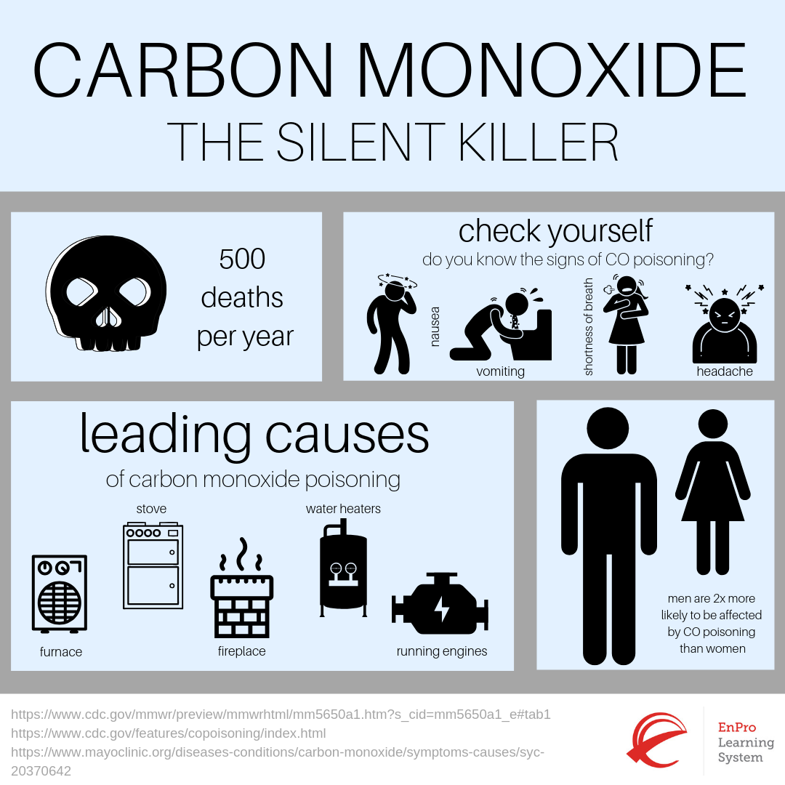
Poisons in the Home:
Carbon Monoxide
Background: Carbon monoxide is a colorless, odorless, tasteless gas that can enter the blood steam if inhaled and cause seizures or death
How Carbon Monoxide Poisoning Happens:
Using fuel-burning appliances, like electrical generators, without proper ventilation
Car exhaust entering the house from the garage
A furnace or water heater not working properly or having blocked exhaust systems
Source: https://www.hud.gov/sites/documents/OHHLHCFLYERCM.PDF
Notes:
Carbon Monoxide-The Silent Killer infographic: https://safety-culture-training.com/Safety-System-News_Blog/carbon-monoxide-safety.aspx
Information taken from:
https://www.hud.gov/sites/documents/OHHLHCFLYERCM.PDF
How Carbon Monoxide Poisoning Happens
Read manufacturer’s instructions prior to using any fuel-burning appliances in your home
Combustion equipment includes things like furnaces and water heaters
Possible symptoms: Headaches, dizziness, and nausea; can easily be misdiagnosed.
More information on Carbon Monoxide Poisoning
https://www.safekids.org/safetytips/field_risks/carbon-monoxide?page=1
https://www.cdc.gov/co/
https://calpoison.org/topics/carbon-monoxide
https://poisonhelp.hrsa.gov/faq/carbon-monoxide
http://www.homesafetycouncil.org/SafetyGuide/sg_co_w001.asp

Slide 16
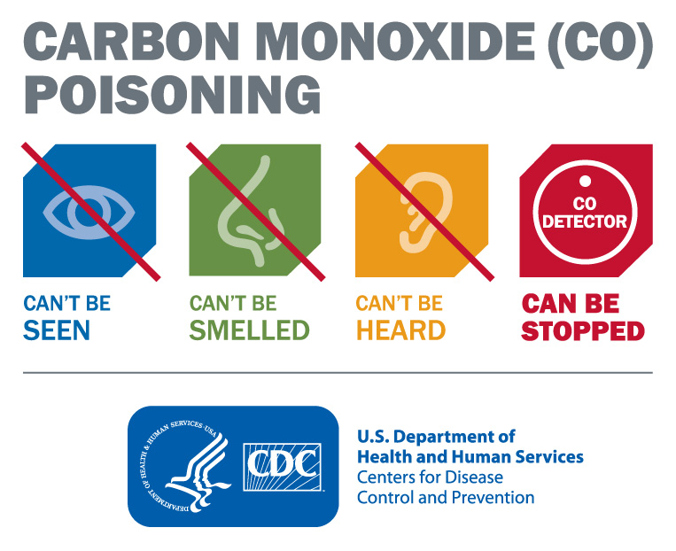
Carbon Monoxide Poisoning: Prevention
Source: https://www.safekids.org/sites/default/files/documents/carbon_monoxide_poisoning_prevention_2015.pdf
Notes:
Carbon Monoxide (CO) Poisoning infographic: https://www.nphic.org/toolkits/carbon-monoxide
Information taken from:
https://www.safekids.org/sites/default/files/documents/carbon_monoxide_poisoning_prevention_2015.pdf
Carbon Monoxide
Install a carbon monoxide alarm on each level of your home
Make sure that installed carbon monoxide alarms are working properly
If you have multiple alarms, connect them if possible
If your carbon monoxide alarm sounds, leave your house immediately
Remove vehicle from the garage immediately after starting it
Use and store gasoline properly
Install alarms near sleeping areas and at least 15 feet away from fuel-burning appliances
Regular carbon monoxide alarm testing should occur once a month
Test alarms regularly and replace them every 5 to 7 years
If alarms are connected, then all will sound if one sounds
Call your fire department’s non-emergency phone number to find out what phone number to call if the carbon monoxide alarm sounds
Carbon monoxide alarms are not substitutes for smoke alarms, and vice versa
Do not use your oven or stovetop to heat your home
Make sure that any vents for indoor appliances are free from debris
Do not use a grill, generator, or camping stove inside your house, garage, or near a window
Store gasoline in a locked location that children cannot access
Away from heat, spark, or flame
Outside your vehicle and living space
Never mix gasoline with fire
More information on carbon monoxide:
https://www.safekids.org/safetytips/field_risks/carbon-monoxide?page=1
https://www.cdc.gov/co/
https://calpoison.org/topics/carbon-monoxide
https://poisonhelp.hrsa.gov/faq/carbon-monoxide
http://www.homesafetycouncil.org/SafetyGuide/sg_co_w001.asp

Slide 17
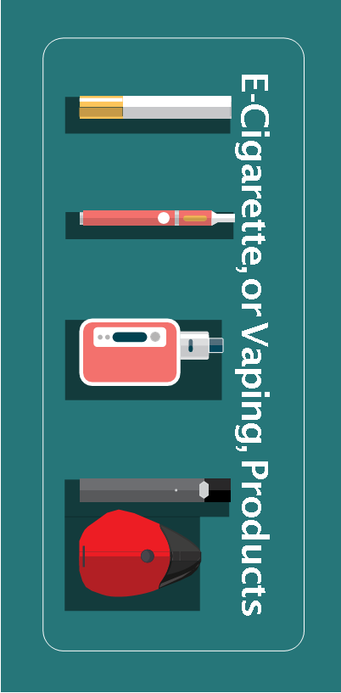
Poisons in the Home:
E-Cigarette and Liquid Nicotine
Background: An e-cigarette contains liquid nicotine and a heating element, which heats the liquid for the user to inhale (sometimes referred to as “vaping”)
How E-Cigarette and Liquid Nicotine Poisonings Happen:
Swallowing liquid nicotine can be toxic
Liquid nicotine can be harmful if spilled on skin or in eye
Nicotine is highly addictive
Nicotine can harm adolescent and young adult brain development
Nicotine is toxic to developing fetuses
E-cigarettes can contain other harmful substances
E-cigarettes can cause unintentional injuries
Sources:
https://www.cdc.gov/tobacco/basic_information/e-cigarettes/about-e-cigarettes.html
https://www.webmd.com/smoking-cessation/nicotine-poisoning-can-you-overdose#1
Notes:
E-Cigarette, or Vaping, Products infographic: https://www.cdc.gov/tobacco/basic_information/e-cigarettes/pdfs/ecigarette-or-vaping-products-visual-dictionary-508.pdf
Information taken from:
https://www.cdc.gov/tobacco/basic_information/e-cigarettes/about-e-cigarettes.html
https://www.webmd.com/smoking-cessation/nicotine-poisoning-can-you-overdose#1
Statistics Around E-Cigarettes
In the United States, youth are more likely than adults to use e-cigarettes
In 2019, over 5 million U.S. middle and high school students used e-cigarettes in the past 30 days, including 10.5% of middle school students and 27.5% of high school students
What Are E-Cigarettes and Liquid Nicotine?
JUUL is a popular brand of e-cigarettes
A single JUUL pod contains approximately 20 times as much nicotine as a cigarette
How E-Cigarette and Liquid Nicotine Poisonings Happen
Other harmful chemicals found in e-cigarettes include cancer-causing agents and tiny particles that reach deep into the lungs
Defective e-cigarettes have caused fires and explosions
You can report such fires and explosions to the FDA here: https://www.fda.gov/tobacco-products/products-ingredients-components/tips-help-avoid-vape-battery-explosions#red
Acute nicotine exposure is incredibly dangerous
Swallowing, breathing, or absorbing e-cigarette liquid through skin or eyes can lead to poisoning
Possible symptoms:
Early (within 15-60 min): Nausea, vomiting, stomachache, mouth watering, rapid breathing, increased heartbeat, increased blood pressure, pale skin, headache, dizziness, confusion
Late (30 min-4 hr): Diarrhea, shallow breathing, slower heartbeat, lower blood pressure, lethargy, feeling weak, slow reflexes, seizures
More information on e-cigarettes and liquid nicotine:
https://www.cdc.gov/tobacco/basic_information/e-cigarettes/pdfs/e-cigarettes-youth-partners-toolkit-508.pdf
https://www.cdph.ca.gov/Programs/CCDPHP/Pages/Vaping-Health-Advisory.aspx
https://www.nobutts-catalog.org/collections/vape
https://www.preventchildinjury.org/toolkits/2015/9/1/liquid-nicotine-toolkit
https://aapcc.org/prevention/tobacco-liquid-nicotine
https://aapcc.org/track/ecigarettes-liquid-nicotine

Slide 18
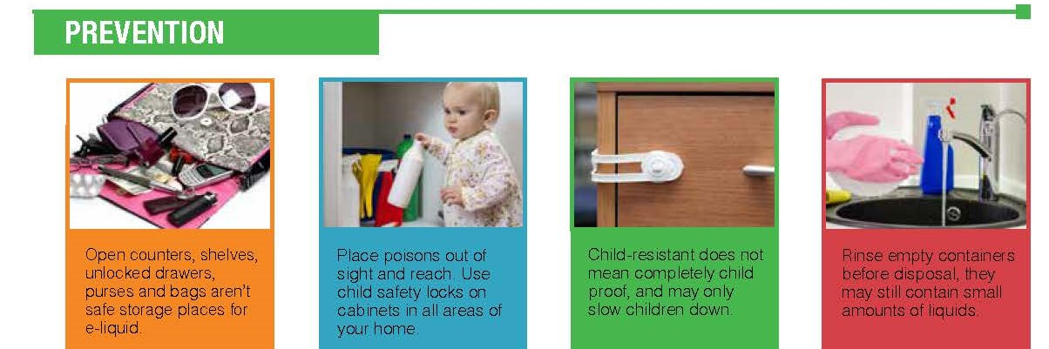
E-Cigarette and Liquid Nicotine: Prevention
Source: https://www.ok.gov/health2/documents/FINAL%20ChildNicotineTobaccoControl_FactSheet%2012.7.2016.pdf/
Notes:
Prevention infographic: https://www.ok.gov/health2/documents/FINAL%20ChildNicotineTobaccoControl_FactSheet%2012.7.2016.pdf/
Information taken from:
https://www.cdc.gov/tobacco/basic_information/e-cigarettes/Quick-Facts-on-the-Risks-of-E-cigarettes-for-Kids-Teens-and-Young-Adults.html
https://www.webmd.com/smoking-cessation/nicotine-poisoning-can-you-overdose#2
E-Cigarettes and Liquid Nicotine
If not nicotine-free, then at least do not smoke in front of children
Have an honest, respectful conversation with your child
Tell them why you want them to stay away from all tobacco products, including e-cigarettes
Seek assistance from your child’s healthcare provider, teacher, or school administrator
Encourage your child to conduct their own research on the topic- give them agency
Children learn by modeling- consider the impact of your own nicotine habits on your child
Talk to your child or teenager about what makes e-cigarettes and nicotine dangerous
Seek help from other trusted adults in your child or teenager’s life
If someone swallows nicotine:
Call 911 if the person can’t wake up, has a hard time breathing, or has a seizure
Let them drink water, but do not induce vomiting or give them antacids
Make sure their airway is clear
More information on e-cigarettes and liquid nicotine:
https://www.cdc.gov/tobacco/basic_information/e-cigarettes/pdfs/e-cigarettes-youth-partners-toolkit-508.pdf
https://www.cdph.ca.gov/Programs/CCDPHP/Pages/Vaping-Health-Advisory.aspx
https://www.nobutts-catalog.org/collections/vape
https://www.preventchildinjury.org/toolkits/2015/9/1/liquid-nicotine-toolkit
https://aapcc.org/prevention/tobacco-liquid-nicotine
https://aapcc.org/track/ecigarettes-liquid-nicotine

Slide 19
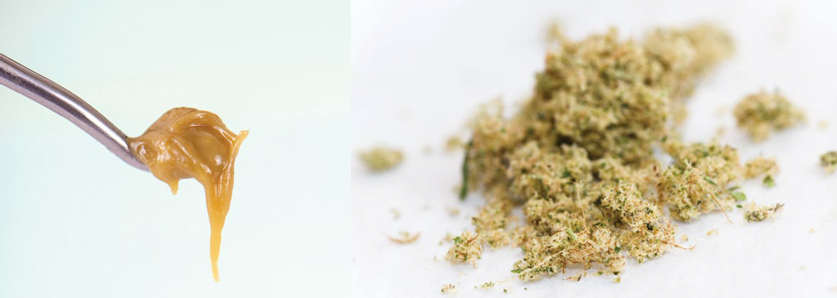
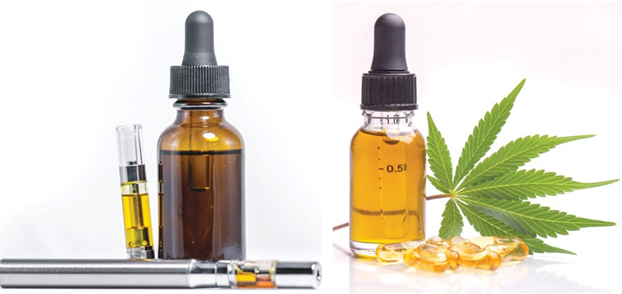
Poisons in the Home:
Marijuana
Background: Marijuana is a product of the hemp plant (Cannabis sativa). The main active ingredient in marijuana is THC.
Examples: Dried, shredded flowers and leaves of the hemp plant (to be smoked), oil and wax extracts, variety of food products
Wax Dry Sift/Keif
How Marijuana Poisonings Happen:
Inhaling smoke can lead to lung problems
High levels of THC can lead to poisoning
Regular use has been linked to depression, anxiety, and suicide
Increases the risk of schizophrenia
Can lead to dependence on other drugs
Can affect brain development
CBD (cannabidiol)
derived from cannabis, marijuana and hemp.
Sources: https://www.cdph.ca.gov/Programs/DO/letstalkcannabis/Pages/Community-Toolkit.aspx | https://drugfree.org/drugs/marijuana/ | https://drugabuse.com/marijuana-abuse/overdose/
Notes:
Images of types of marijuana: https://www.cdc.gov/tobacco/basic_information/e-cigarettes/pdfs/ecigarette-or-vaping-products-visual-dictionary-508.pdf
Information taken from:
https://www.cdph.ca.gov/Programs/DO/letstalkcannabis/Pages/Community-Toolkit.aspx
https://drugfree.org/drugs/marijuana/
https://drugabuse.com/marijuana-abuse/overdose/
What to Know About Marijuana
Though the legalization of the drug has led to the belief that it is relatively harmless, it can have negative consequences
How Marijuana Poisonings Happen
Inhaling toxins in smoke can lead to lung problems
High levels of THC can lead to poisoning
Regular use has been linked to depression, anxiety, and suicide
Increases the risk of schizophrenia
Can lead to dependence on other drugs
Can affect brain development
Marijuana smoke contains many of the same toxins as cigarettes
Cannabis is grown differently than it used to be—many cannabis plants now have higher levels of THC
THC poisoning is especially prevalent when ingesting edibles
Unlike with smoking marijuana, where the effects are immediate, the effects of THC in edibles take about 30 minutes to arise; because of this relatively long period, the person ingesting the edibles may eat more, eventually ingesting an amount of THC that could lead to poisoning
The onset of schizophrenia from cannabis use is not common, but the risk increases with use
THC is addictive and can lead to a dependence on marijuana, which can lead to a dependence on other drugs
The brain is not fully developed until age 25—using marijuana in teenage years and early 20s can have affects on the way that the brain develops (particularly the prefrontal cortex)
Common symptoms: Extreme anxiety/panic attacks, paranoia, hallucinations, decreased judgment/perception, increased heart rate, uncontrollable shaking/seizures, pale skin, unresponsiveness, increased blood pressure, headache
More information on marijuana:
https://aapcc.org/track/synthetic-cannabinoids
https://aapcc.org/CBD-Alert
https://www.cdph.ca.gov/Programs/DO/letstalkcannabis/Pages/Community-Toolkit.aspx
https://www.healthychildren.org/English/ages-stages/teen/substance-abuse/Pages/Edible-Marijuana-Dangers.aspx
https://www.heretohelp.bc.ca/workbook/cannabis-use-and-youth-a-parents-guide
https://www.aacap.org/AACAP/Families_and_Youth/Facts_for_Families/FFF-Guide/Marijuana-and-Teens-106.aspx
https://www.childrenssafetynetwork.org/webinar/synthetic-marijuana-what-it-why-it-dangerous-how-can-we-prevent-youth-using-it
https://www.poison.org/articles/2012-oct/dangers-of-illegal-spice-and-bath-salts
https://www.poison.org/articles/2011-jun/drugs-of-abuse-fake-pot-and-cocaine
https://www.poison.org/articles/2014-dec/marijuana
https://www.poison.org/articles/2013-dec/medical-marijuana

Slide 20
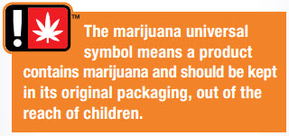
Carbon Monoxide Poisoning: Prevention
Children learn by modeling- consider the impact of your own marijuana use on your child
Talk to your child honestly about the dangers of marijuana use
Seek help from other trusted adults in your child or teenager’s life
Source: https://drugfree.org/article/how-to-talk-about-marijuana/
Notes:
Image of marijuana label: https://www.healthychildren.org/English/ages-stages/teen/substance-abuse/Pages/Edible-Marijuana-Dangers.aspx
Information taken from:
https://drugfree.org/article/how-to-talk-about-marijuana/
Marijuana
Educate your child on the various forms in which they might come into contact with marijuana
Encourage your child/teen to do research on their own
At the very least, work with your child to establish safer practices for marijuana use
Discuss the differences between medicinal marijuana and recreational marijuana
Educate/encourage your child to learn about the laws surrounding marijuana use
More information on cannabis:
https://aapcc.org/track/synthetic-cannabinoids
https://aapcc.org/CBD-Alert
https://www.cdph.ca.gov/Programs/DO/letstalkcannabis/Pages/Community-Toolkit.aspx
https://www.healthychildren.org/English/ages-stages/teen/substance-abuse/Pages/Edible-Marijuana-Dangers.aspx
https://www.heretohelp.bc.ca/workbook/cannabis-use-and-youth-a-parents-guide
https://www.aacap.org/AACAP/Families_and_Youth/Facts_for_Families/FFF-Guide/Marijuana-and-Teens-106.aspx
https://www.childrenssafetynetwork.org/webinar/synthetic-marijuana-what-it-why-it-dangerous-how-can-we-prevent-youth-using-it
https://www.poison.org/articles/2012-oct/dangers-of-illegal-spice-and-bath-salts
https://www.poison.org/articles/2011-jun/drugs-of-abuse-fake-pot-and-cocaine
https://www.poison.org/articles/2014-dec/marijuana
https://www.poison.org/articles/2013-dec/medical-marijuana

Slide 21
Poisons Outside the Home
Plants
Seasonal

Slide 22


Poisons Outside the Home: Plants
African Iris, a nontoxic plant.
How Plant Poisonings Happen:
Plant poisonings typically happen due to ingestion of plant
Reactions to plants vary based on age and size of the patient, health factors such as allergies, and the amount of the exposure
Calla Lily, a poisonous plant.
Sources:
https://calpoison.org/topics/plant
https://www.cdc.gov/niosh/topics/plants/symptoms.html
http://www.healthofchildren.com/P/Poisoning.html
Notes:
Image of African Iris: https://www.mygardenlife.com/plant-library/6661/dietes/iridioides
Image of Calla Lily: https://www.dovemed.com/healthy-living/first-aid/first-aid-calla-lily-poisoning/
Information taken from:
https://calpoison.org/topics/plant
https://www.cdc.gov/niosh/topics/plants/symptoms.html
http://www.healthofchildren.com/P/Poisoning.html
Possible symptoms*: Rash, swelling, itching, nausea, vomiting, convulsions, irregular heartbeat
*Reactions and symptoms will vary based on the plant and the amount of exposure
Comprehensive list of toxic and non-toxic plants can be found at:
https://calpoison.org/topics/plant

Slide 23
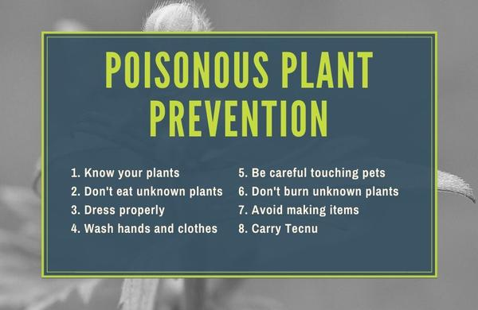
Poisonous Plants: Prevention
Source: https://www.greenbelly.co/pages/poisonous-plants-identification-guide
Notes:
Image of Poisonous Plant Prevention tip sheet: https://www.greenbelly.co/pages/poisonous-plants-identification-guide
Prevention Practices:
8 Golden Rules of Poison Prevention
Benjamin Franklin once said "an ounce of prevention is worth a pound of cure" when addressing fire safety and that axiom applies to poisonous plants as well. The best way to handle toxic plants on the trail is to prevent exposure to them using these common-sense tips.
1. Know your plants: know which plants are harmful so you can avoid them and minimize your exposure.
2. Don't eat unknown plants: NEVER eat a plant or berry unless you can positively identify it as being unharmful. Even then, it needs to be washed thoroughly, or potentially cooked to ensure its safe to consume.
3. Dress properly: wear long pants and shirts when possible to minimize contact with their skin.
4. Wash your hands and clothing: when you encounter an unknown and possibly harmful plant, you should wash your hands or the clothing that came in contact with the plant.
5. Be careful touching pets: pets can carry the oils of poisonous plants on their fur. When you pat them, the poison substance is transferred to your hands.
6. Don't burn unknown plants: burning a plant may get rid of it, but the smoke may contain poisonous compounds. Inhaling fumes from poisonous plants can be very hazardous.
7. Avoid making items: it may be fun to craft a nature necklace using plants and leaves, but you may regret it if you accidentally used a poisonous plant in your creation.
8. Carry Tecnu: Tecnu is an effective wash that'll decontaminate your skin, your pet's fur, clothing or gear.
You have to research the toxic plants that are native to the area in which you are hiking and then learn to recognize these plants in the wild. Our guide breaks down these harmful plants by the symptoms that they cause.
Information taken from:
https://www.greenbelly.co/pages/poisonous-plants-identification-guide

Slide 24

Poisons Outside the Home: Seasonal Hazards
Summer Bites and stings Lamp oil and lighter fluid Fireworks Insect spray or lotion | Winter Holiday décor Antifreeze Mercury (in thermometers) Carbon monoxide
Spring Pesticides Mushrooms | Fall Berries Back-to-School items
Source: https://poisonhelp.hrsa.gov/resources/toolkits
Notes:
Image of the four seasons: https://www.publicdomainpictures.net/pictures/40000/velka/seasonal-banners.jpg
Information taken from:
https://poisonhelp.hrsa.gov/resources/toolkits
More information on seasonal poison hazards
https://aapcc.org/prevention/seasonal
https://aapcc.org/prevention/bites-stings

Slide 25
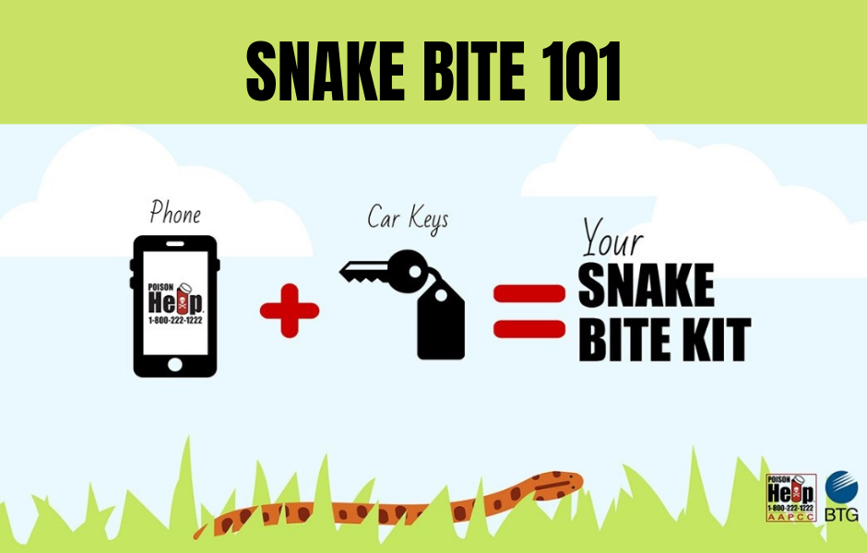
Seasonal Hazards: Prevention
Source: https://www.ohsu.edu/oregon-poison-center/seasonal-poisoning-hazards
Notes:
Snake Bite 101 flyer: https://www.ohsu.edu/oregon-poison-center/seasonal-poisoning-hazards
Seasonal Hazards: Prevention
Be aware of seasonal hazards specific to your location
Research various seasonal hazards and their prevention using resources such as
https://www.poison.org/poison-prevention-tips-by-season
https://www.aapcc.org/prevention/seasonal-poisoning-hazards
https://www.ohsu.edu/oregon-poison-center/seasonal-poisoning-hazards
https://www.kansashealthsystem.com/care/centers/poison-control-center/seasonal-poisoning-hazards

Slide 26
What to do if your child is poisoned
Call 911 if the individual is unconscious, convulsing, or struggling to breathe
Otherwise:
  Call the California Poison Control Center at 1-800-222-1222 OR
  Report the incident using webPOISONCONTROL
Follow the proper procedures for:
  Eye contact
  Swallowed medicine
  Skin contact
  Chemical or household products
  Inhaled products
Source: https://calpoison.org/emergency
Notes:
Information taken from: https://calpoison.org/emergency
When calling either 911 or the California Poison Control Center:
Be prepared to give the operator the following information:
Age and weight of the person
What was ingested (have the bottle or container with you)
How much was taken
How the victim is feeling or acting right now
Your name and phone number
Use the proper procedures for:
Eye contact
Flood the eye with lukewarm water and repeat for 15 minutes
Encourage patient to blink while flushing the eye
Do not force the eyelid open
Swallowed medicine
Do not give anything by mouth until calling for advice
Skin contact
Remove contaminated clothing, then flood skin with water for 15 minutes
Wash gently with soap and water and rinse
Chemical or household products
Unless patient is unconscious, having convulsions, or cannot swallow, give a small amount of water
Call for professional advice to find out if the patient should be made to vomit
Do not induce vomiting unless recommended by your physician or the Poison Center
Inhaled
Immediately get the patient to fresh air
Avoid breathing fumes– open doors and windows
If the individual is not breathing, call for help and start assisted (mouth-to-mouth) breathing
Information on the California Poison Control System:
The California Poison Control System provides immediate, free, and expert treatment advice and referral over the telephone in case of exposure to poisonous or toxic substances
Pharmacists, nurses, and poison information providers answer the calls to 1-800-222-1222 and are available 24 hours a day, 7 days a week, 365 days a year
Language interpreters are always available, just say the language you need when you call.
Services for the deaf and hearing impaired offered through the California Relay Service
More information on general poisoning responses:
https://www.poison.org/actfast

Slide 27
Summary
Keep potentially harmful products up and away
1
Practice food safety
2
Educate your child about e-cigarettes and marijuana
3
Model good habits for children
4
Post the Poison Control number (1-800-222-1222)
5

Slide 28
Poison Prevention:
Local Resources & Contact Information
Community resources near you:
[Include county-specific and local resources here]
Thank you!

Slide 29
Poison Prevention:
Additional Information
Safe Kids (Poison Prevention)
American Association of Poison Control Centers
National Capital Poison Center
Children’s Safety Network
Health Resources and Services Administration
California Poison Control
UC Davis Medical Center (Poison Control System-Sacramento Division)
Notes:
Other General Resources (please adjust links as you see fit):
CDC (Carbon Monoxide Poisoning): https://www.cdc.gov/co/
CDC (Home and Recreational Safety-Poisoning): https://www.cdc.gov/homeandrecreationalsafety/poisoning/index.html
Prevent Child Injury: https://www.preventchildinjury.org/toolkits-landing
Food Safety-Food Poisoning: https://www.foodsafety.gov/food-poisoning
Home Safety Council-Safety Guide: http://www.homesafetycouncil.org/SafetyGuide/sg_poison_w005.asp
NIH (Tox Town): https://toxtown.nlm.nih.gov/
Up and Away Campaign: https://www.upandaway.org/
California Smokers’ Hotline: https://www.nobutts-catalog.org/collections/vape
California Department of Public Health (Vaping Health Advisory): https://www.cdph.ca.gov/Programs/CCDPHP/Pages/Vaping-Health-Advisory.aspx
CDC (E-cigarettes): https://www.cdc.gov/tobacco/basic_information/e-cigarettes/about-e-cigarettes.html
CDPH (Let’s Talk Cannabis):
Parents and Mentors: https://www.cdph.ca.gov/Programs/DO/letstalkcannabis/Pages/parents-mentors.aspx
Community Toolkit: https://www.cdph.ca.gov/Programs/DO/letstalkcannabis/Pages/Community-Toolkit.aspx
Healthy Children (Edible Marijuana): https://www.healthychildren.org/English/ages-stages/teen/substance-abuse/Pages/Edible-Marijuana-Dangers.aspx
Drug Free (How to Talk About Marijuana): https://drugfree.org/article/how-to-talk-about-marijuana/
Here to Help (Cannabis Use and Youth): https://www.heretohelp.bc.ca/workbook/cannabis-use-and-youth-a-parents-guide
AACAP (Marijuana and Teens): https://www.aacap.org/AACAP/Families_and_Youth/Facts_for_Families/FFF-Guide/Marijuana-and-Teens-106.aspx

Slide 30
Photo Attributions & Additional Information
Image of child holding basket of mushrooms: https://calpoison.org/
Image of medicine bottle: http://clipart-library.com/clipart/944086.htm
Up and Away infographic: https://safekids.org/infographic/childproofing-steps-six-items-keep-and-away
Image of child reaching into sink cabinet: https://www.nsc.org/home-safety/safety-topics/other-poisons/household-products
Keeping Kids Safe Around Liquid Laundry Packets infographic: https://safekids.org/infographic/keeping-kids-safe-around-liquid-laundry-packets
Image of magnifying glass on food: https://safetymanagementgroup.com/keeping-food-from-poisoning-your-workplace/
Carbon Monoxide-The Silent Killer infographic: https://safety-culture-training.com/Safety-System-News_Blog/carbon-monoxide-safety.aspx
Carbon Monoxide (CO) Poisoning infographic: https://www.nphic.org/toolkits/carbon-monoxide
E-Cigarette, or Vaping, Products infographic: https://www.cdc.gov/tobacco/basic_information/e-cigarettes/pdfs/ecigarette-or-vaping-products-visual-dictionary-508.pdf
Prevention infographic: https://www.ok.gov/health2/documents/FINAL%20ChildNicotineTobaccoControl_FactSheet%2012.7.2016.pdf/
Images of types of marijuana: https://www.cdc.gov/tobacco/basic_information/e-cigarettes/pdfs/ecigarette-or-vaping-products-visual-dictionary-508.pdf

Slide 31
Photo Attributions & Additional Information
Image of marijuana label: https://www.healthychildren.org/English/ages-stages/teen/substance-abuse/Pages/Edible-Marijuana-Dangers.aspx
Image of African Iris: https://www.mygardenlife.com/plant-library/6661/dietes/iridioides
Image of Calla Lily: https://www.dovemed.com/healthy-living/first-aid/first-aid-calla-lily-poisoning/
Image of Poisonous Plant Prevention tip sheet: https://www.greenbelly.co/pages/poisonous-plants-identification-guide
Image of the four seasons: https://www.publicdomainpictures.net/pictures/40000/velka/seasonal-banners.jpg
Snake Bite 101 flyer: https://www.ohsu.edu/oregon-poison-center/seasonal-poisoning-hazards

